Slide 1

Statement of Work:
Comprehensive Guide on Integrating SharePoint with Microsoft Teams
Notes:
Notes: To assist Andrew and he’s teams in integrating Microsoft Teams and SharePoint through a DIY approach, it's important to gather and organize self-help materials. Here's a detailed guide on how to find and structure these resources:

Slide 2

Objective
Develop an informative, easy-to-follow guide that enables users to effectively integrate and utilize SharePoint within Microsoft Teams.
The guide aims to enhance collaboration, streamline document management, and leverage SharePoint’s features within the Teams environment.
Notes:
Self-Implementation Resources:
These are detailed guides and tutorials for setting up and using Microsoft Teams and SharePoint.
Where to Find:
Microsoft Support Pages: The official Microsoft website offers comprehensive documentation for both Teams and SharePoint. Look for guides under their respective sections.
YouTube Tutorials: Search on YouTube for tutorials. Channels like Microsoft Mechanics or independent tech experts often post in-depth walkthroughs.
Tech Blogs: Explore TechRepublic, CNET, and ZDNet for articles and guides.

Slide 3
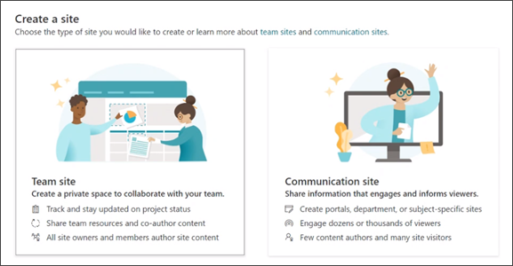
Scope
Introduction to SharePoint in Teams
Overview of Integration
Benefits of Integration
Creating a New Team Site in SharePoint
Accessing SharePoint from Teams
Steps to Create a New Team Site
Best Practices for Team Site Setup
Notes:
Suggested Indexing:
A. Setting Up SharePoint:
A.1. Creating SharePoint Sites
A.2. Managing Permissions and Security
A.3. Organizing Files and Folders
B. Setting Up Microsoft Teams:
B.1. Creating Teams and Channels
B.2. Integrating Teams with SharePoint
B.3. Customizing Teams Settings

Slide 4
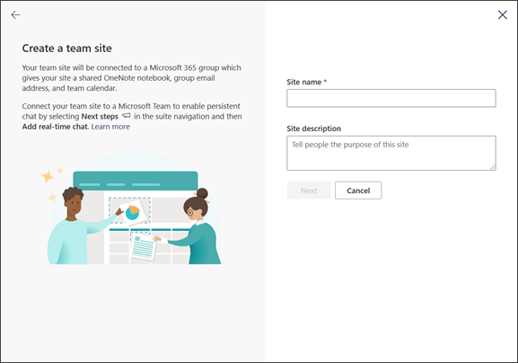
Scope Cont.
Adding SharePoint Elements to Teams
Adding SharePoint Pages as Tabs
Integrating SharePoint Document Libraries
Incorporating SharePoint Lists
Managing Permissions and Security in SharePoint and Teams
Understanding and Managing Permissions
Security Best Practices
Notes:
Suggested Indexing:
SharePoint Training:
C.1. Basic SharePoint Navigation and Use
C.2. Advanced Document Management
C.3. SharePoint Administration
Teams Training:
D.1. Basic Use of Teams
D.2. Advanced Collaboration in Teams
D.3. Teams for Project Management
Additional Tips:
Regular Updates: Microsoft's frequent updates mean staying current with the latest guides and features.
Online Communities: Utilize platforms like Stack Overflow, Reddit (SharePoint and MicrosoftTeams subreddits), and the Microsoft Tech Community for community support.

Slide 5
Scope Cont.
Collaborating on Documents and Files
Co-Authoring Documents in Teams
Managing Version Control
Advanced SharePoint Features in Teams
Implementing SharePoint Workflows and Power Automate
Integrating Custom SharePoint Solutions or Apps
Notes:
Here are some resources that might help you with implementing SharePoint workflows and Power Automate:
Microsoft Learn: This article provides an overview of how Teams and SharePoint work together, including the basic parts of Teams and SharePoint and how they relate to each other. It also explains when Teams and SharePoint get connected and provides examples of teams with multiple channel types¹
SharePoint Sharks: This blog post provides user best practices and guidelines for Microsoft Teams sites, including tips on adding navigation tabs for resources within your SharePoint Teams site, using private chat for one-to-one conversations, and using the channel conversation to share knowledge and information with the team²
Intranet Blog: This blog post provides best practices for Microsoft Teams and SharePoint integration, including tips on looking up files instantly through a single search system, linking documents straight into a conversation to keep the topic clear, and generating automatic previews in Microsoft Team’s channel tab through SharePoint³
Microsoft Support: This guide focuses on the powerful capabilities of Teams, SharePoint, and OneDrive, including document storage, collaboration, sharing, and conversations. It also explains how each tool works together to provide optimal productivity⁴
Microsoft Learn: This article provides a tutorial on how to set up lists for SharePoint Online integration with Power Apps, Power Automate, and Power BI. It explains how to create and review the lists, and how to use them as a data source for apps, flows, reports, and dashboards¹
SuperSimple365: This blog post explains how to create and manage Power Apps from Microsoft Lists within Microsoft Teams. It also provides a step-by-step guide on how to create an app from a list and populate it with sample data²
Microsoft Support: This article explains how to find your SharePoint and Teams files in OneDrive for work or school. It also provides instructions on how to access your SharePoint or Microsoft Teams files in the OneDrive mobile app³
Microsoft Learn: This article compares Microsoft Lists, Dataverse for Teams, and Dataverse, and provides key considerations that will help you pick the correct data source for your app⁴

Slide 6
Scope Cont.
Best Practices for Using SharePoint in Teams
Tips for Encouraging Adoption and Effective Use
Troubleshooting Common Issues
Conclusion and Additional Resources
Summary of Key Points
Links to Further Learning and Resources
Notes:
Information on how to use SharePoint in Teams. Here are some resources that might help you:
Microsoft Learn: This article provides an overview of how Teams and SharePoint work together, including the basic parts of Teams and SharePoint and how they relate to each other. It also explains when Teams and SharePoint get connected and provides examples of teams with multiple channel types¹
SharePoint Sharks: This blog post provides user best practices and guidelines for Microsoft Teams sites, including tips on adding navigation tabs for resources within your SharePoint Teams site, using private chat for one-to-one conversations, and using the channel conversation to share knowledge and information with the team²
Intranet Blog: This blog post provides best practices for Microsoft Teams and SharePoint integration, including tips on looking up files instantly through a single search system, linking documents straight into a conversation to keep the topic clear, and generating automatic previews in Microsoft Team’s channel tab through SharePoint³
Microsoft Support: This guide focuses on the powerful capabilities of Teams, SharePoint, and OneDrive, including document storage, collaboration, sharing, and conversations. It also explains how each tool works together to provide optimal productivity⁴

Slide 7

Deliverables
Written Guide
Comprehensive text-based content covering all scope areas.
Inclusion of step-by-step instructions for each process.
Visual Aids
Relevant screenshots demonstrating key steps and features.
Diagrams, flowcharts, and other visual tools to enhance understanding.
Supplementary Materials
A glossary of terms.
A section of Frequently Asked Questions (FAQs).
Notes:
Here are some resources that might help you with SharePoint, Teams, Power Apps, OneDrive, and Lists:
Microsoft Learn: This article provides an overview of how Teams and SharePoint work together, including the basic parts of Teams and SharePoint and how they relate to each other. It also explains when Teams and SharePoint get connected and provides examples of teams with multiple channel types¹
SharePoint Sharks: This blog post provides user best practices and guidelines for Microsoft Teams sites, including tips on adding navigation tabs for resources within your SharePoint Teams site, using private chat for one-to-one conversations, and using the channel conversation to share knowledge and information with the team²
Intranet Blog: This blog post provides best practices for Microsoft Teams and SharePoint integration, including tips on looking up files instantly through a single search system, linking documents straight into a conversation to keep the topic clear, and generating automatic previews in Microsoft Team’s channel tab through SharePoint³
Microsoft Support: This guide focuses on the powerful capabilities of Teams, SharePoint, and OneDrive, including document storage, collaboration, sharing, and conversations. It also explains how each tool works together to provide optimal productivity⁴
Microsoft Learn: This article provides a tutorial on how to set up lists for SharePoint Online integration with Power Apps, Power Automate, and Power BI. It explains how to create and review the lists, and how to use them as a data source for apps, flows, reports, and dashboards¹
SuperSimple365: This blog post explains how to create and manage Power Apps from Microsoft Lists within Microsoft Teams. It also provides a step-by-step guide on how to create an app from a list and populate it with sample data²
Microsoft Support: This article explains how to find your SharePoint and Teams files in OneDrive for work or school. It also provides instructions on how to access your SharePoint or Microsoft Teams files in the OneDrive mobile app³
Microsoft Learn: This article compares Microsoft Lists, Dataverse for Teams, and Dataverse, and provides key considerations that will help you pick the correct data source for your app⁴

Slide 8

Timeline
1. Draft Completion: 12-Dec-23
2. Review and Revisions: 12-Dec-23
3. Final Guide Delivery: 12-Dec-23

Slide 9

Review and Approval Process
Draft review by [Insert Reviewer/Team Name]
Incorporation of feedback and revisions
Final approval by [Insert Approver’s Name/Title]

Slide 10
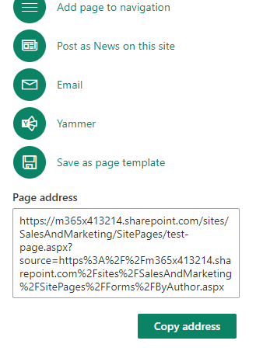
Resources and Collaboration
Access to SharePoint and Teams for capturing screenshots and examples.
Collaboration with the IT team for technical accuracy.
raydo@skunkworks.afica
+27 83 380 7950

